Slide 1

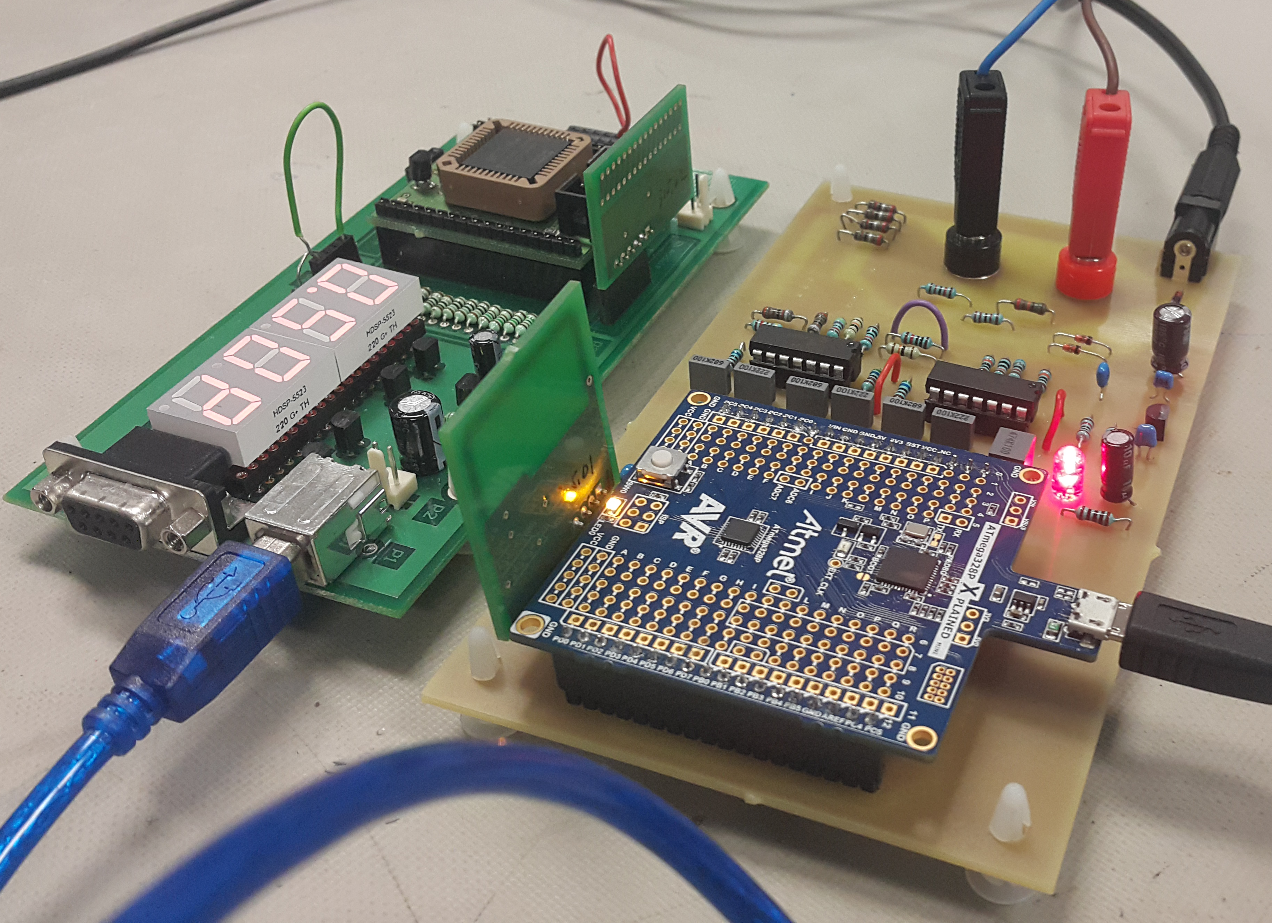

James Ashworth
Adil Bhayani
Savi Mohan
Mark Yep
A Smart Energy Monitor
Lecturers:
Muhammad Nadeem
Duleepa Thrimawithana
ELECTENG 209 Smart Energy Challenge Group 37
Background
System Flowchart
ELECTENG 209 is an electronics design paper, taken in the second semester by every second year Electrical and Computer Systems Engineering student. The goal of this years project was to design and develop a wireless energy monitor to measure and display the amount of energy consumed by a household appliance in a smart house. Due to safety reasons, each group designed and developed a proof of concept project, which works as a scaled down system.
Microcontroller measures V and I through ADC
Data is sent to CPLD via Radio UART
V
Microcontroller
(From Analogue Circuit)
I
UART
Smart Energy Challenge
CPLD
CPLD receives UART and displays on seven segment display
CPLD sends data to laptop via serial RS232
Seven Segment Display
As an extension of the regular project, the lecturers offered an optional Smart Energy Challenge. In this extension groups were required to read and graph the real time energy readings on a computer.
Additionally, our group decided that we wanted to make our Smart Energy Challenge extension truly smart. This lead us to develop an Android application for use on Android based smartphones.
Figure 1: The analogue PCB with the Atmel Xplained Mini, CPLD, and RF modules
RS232
Graphing
Laptop
Python reads serial data, displays on console, and graphs in real time
Uploads to Firebase
Technologies and Frameworks
(On Laptop Screen)
Throughout our entire project we utilised many current frameworks and technologies. These include:
Analogue Circuit Design
LTSpice
Altium
Version Control System
GitHub
Microcontroller C
Atmel Studio
VHDL
Altera Quartus
Python
RS232 serial data – pySerial library
Real Time Graphing – matplotlib library
Firebase – Firebase library
Firebase
JSON
Google Requests
Android App
Android Studio
Firebase dependencies
Google Requests dependencies
Console
Prototype Specifications
Wi-Fi
The proof of concept prototype that we created is able to work with the following specifications:
Source Voltage – 12 to 14 V_{rms}
Source Frequency – 500 Hz ± 10%
Maximum Load – 8.5 VA
Additionally our project features:
Voltage and current sensing circuits
Signal conditioning circuits
Digital processing and calculation system
(Atmel AVR Microcontroller based)
Wireless Radio Frequency UART
Digital base station display system (CPLD based)
Python real time graphing
Firebase real time database
Android real time graphing
Firebase
Receives data in real time from Python
Stored as Key: Value pairs, each value is encoded in JSON
Wi-Fi
Graphing
Android App
Receives real time data from Firebase
Displays current data
and real time graphing
(On Smartphone Screen)
Latest Data
Background image from: https://upload.wikimedia.org/wikipedia/commons/e/ef/ISS-42_New_Zealand_in_Sunglint,_large_resolution.jpg

